Slide 1
P2P Communication System
By
Sarang parikh (1nt16is107)
Prashanth p wagle (1nt16is086)

Slide 2
Definition and Meaning
P2P stands for “Peer to Peer”.
It is a decentralized communication system.
In a P2P network, the "peers" are computer systems which are connected to each other via the Internet or a private network connection without the need of a centralized server.
Decentralized Computing: Decentralized computing is the allocation of resources, both hardware and software, to each individual workstation, or office location. In contrast, centralized computing exists when the majority of functions are carried out, or obtained from a remote centralized location.

Slide 3
The Importance of Decentralization
The potential problems of a centralised communication systems are:
Servers Can Go Down
Servers Can Be Hacked
Companies Throttle or Censor Data
Companies Monetize Your Data

Slide 4
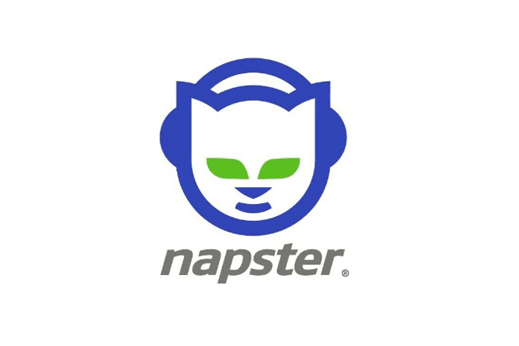
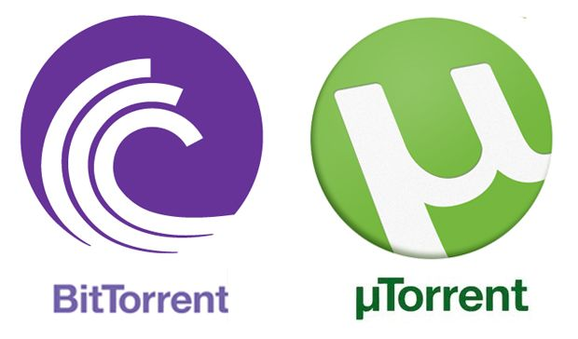
Organizations benefitted by decentralized systems
Pioneering Peer to Peer Music Sharing Service
Both are BitTorrent clients which use BitTorrent Protocol in
which users can simultaneously upload/download files
to/from each other.

Slide 5
Our System
Connect
Send
A message sent by one computer will be broadcasted to all computers in the network.
Receive
All computers connected to the network will receive the message sent by the sender.
Computers with no connectivity connect to the “peers”
Recognize devices that are “Up”.
The contents of the conversation will be updated.
Will take place by GET request of the HTTP protocol.
Device that connect to the already established network get a copy of the conversation.

Slide 6
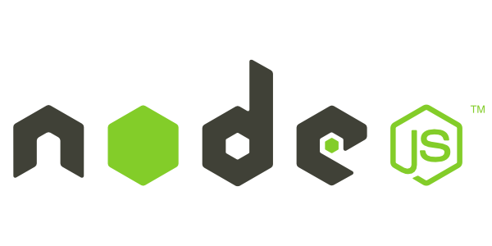


Technologies Requirements

Slide 7
Working (Phase-1)
After the establishment of a p2p network connection, if a node wants to broadcast a message to other
Peers, it will do so via the HTTP GET request through any browser.
As soon as message is received by every node, the “message box” i.e. text file of every node is updated.
The updated message box is distinctively recognised from the outdated message box by the “Hash” of the
Message box by the hashing algorithm i.e. the hash of the updated message box will be changed.
Every node here behaves as a server and the server programming i.e. backend is done using Node.js
Which is a JavaScript framework.
The hardware emulation, topology and simulation is done using the network simulation tool,
Cisco Packet Tracer.
Packet Tracer also helps in capturing and analysing the packets sent/received by the connected nodes.

Slide 8
THANK YOU!

